Slide 1
Quality Check Your Recon
Do your surfaces follow gm/wm borders?
Does the subcortical segmentation follow intensity boundaries?
Notes:
-accurately follow boundaries?

Slide 2
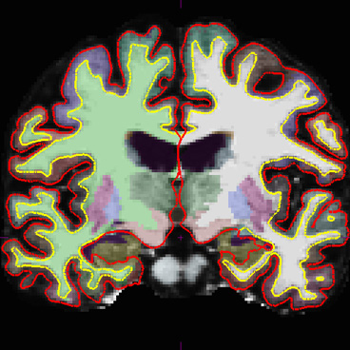
Output of Cortical Surface Reconstruction
Notes:
-turn surfaces on/off to check; change brightness & contrast; is this where I would draw boundary?
-certain areas that don’t matter: surfaces near subcortical structures
-surfaces for wm/gm don’t check aseg for gm/wm

Slide 3
How Know What to Edit?
If it affects the pial surface:
  edit brainmask.mgz
If it affects the white surface:
  edit the wm.mgz (if segmentation error)
  add control points (if normalization error)

Slide 4
Troubleshooting – Advice
FLOW
AMBIGUITY
CONSISTENCY
Edit consistently within and across subjects.
SPEED
You will get faster with time; certain sections go faster.

Slide 5
Must rerun to fix errors
recon-all -autorecon2 -autorecon3 (Stages 6+)
Skull strip error (after fixed watershed/cloned)
recon-all -autorecon2 -autorecon3 (Stages 10+)
Added control points
recon-all -autorecon2-wm -autorecon3 (Stages 13+)
Edited wm.mgz
recon-all -autorecon-pial (Stage 19+)
Edited brainmask.mgz

Slide 6
Or Make Life Easier
recon-all -make all -s subjid

Slide 7
Start Over
recon-all -all -clean -s subjid

